Slide 1
Mini-project-3
By Winnie Wetthasinghe
19/05/2021

Slide 2
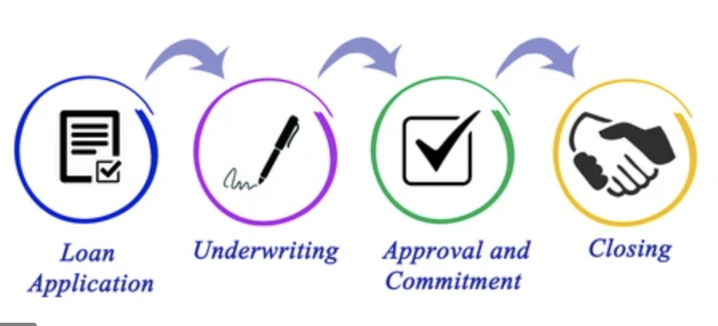
Introduction & project objective
In a lending process, customer first apply for a loan then a company validates the customer eligibility for loan.
Company wants to automate the loan eligibility process based on customer detail provided while filling online application form.
To automate this process, identify the customers segments, those are eligible for loan amount so that they can specifically target these customers.
Loan prediction is a very common real-life problem that each retail bank faces. It can help assess risks and save a lot of man hours.
This project focuses on implementing ML models that can predict whether future customers are eligible to apply for a loan.

Slide 3
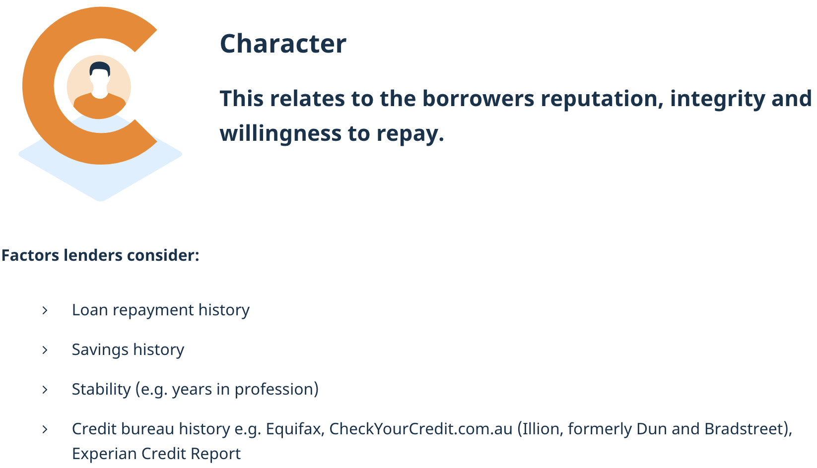
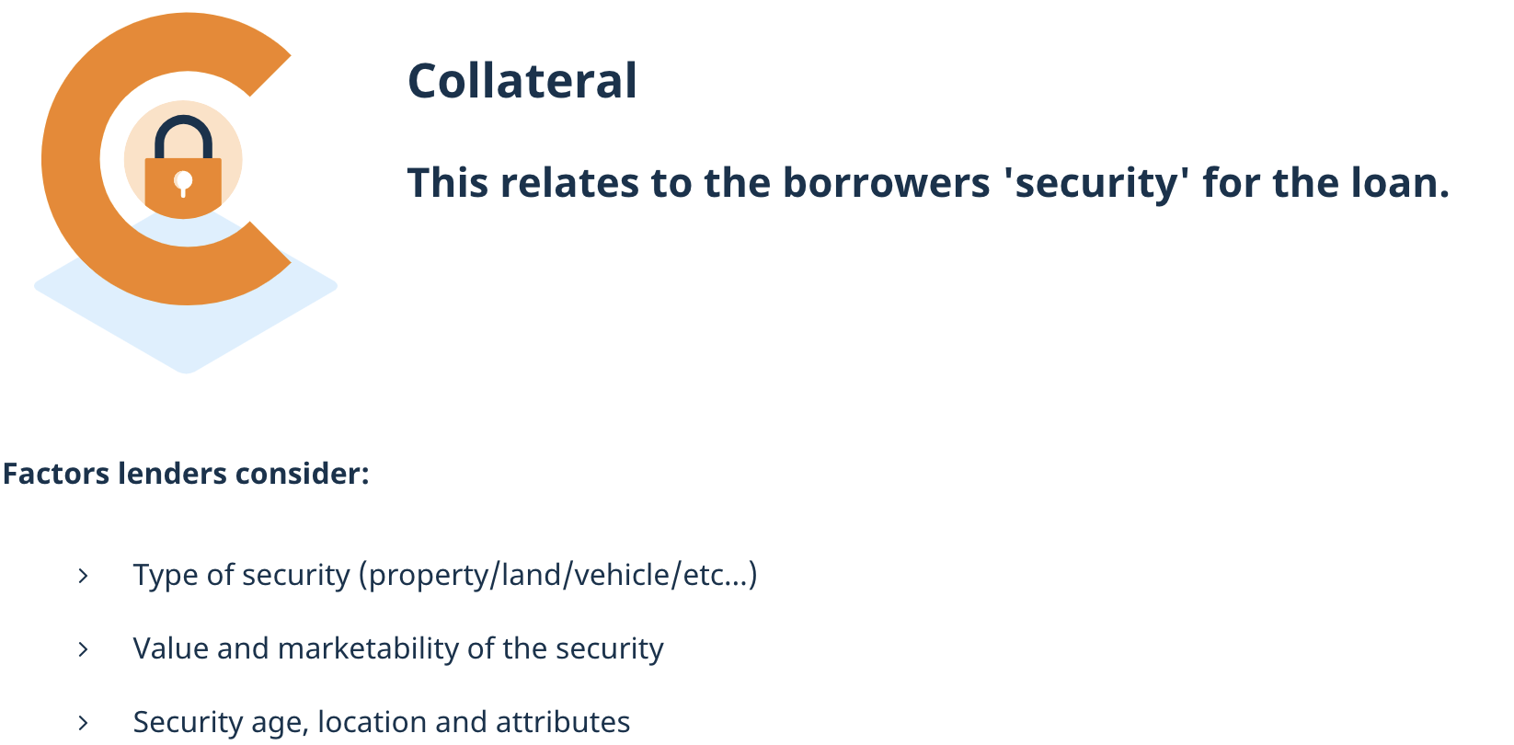
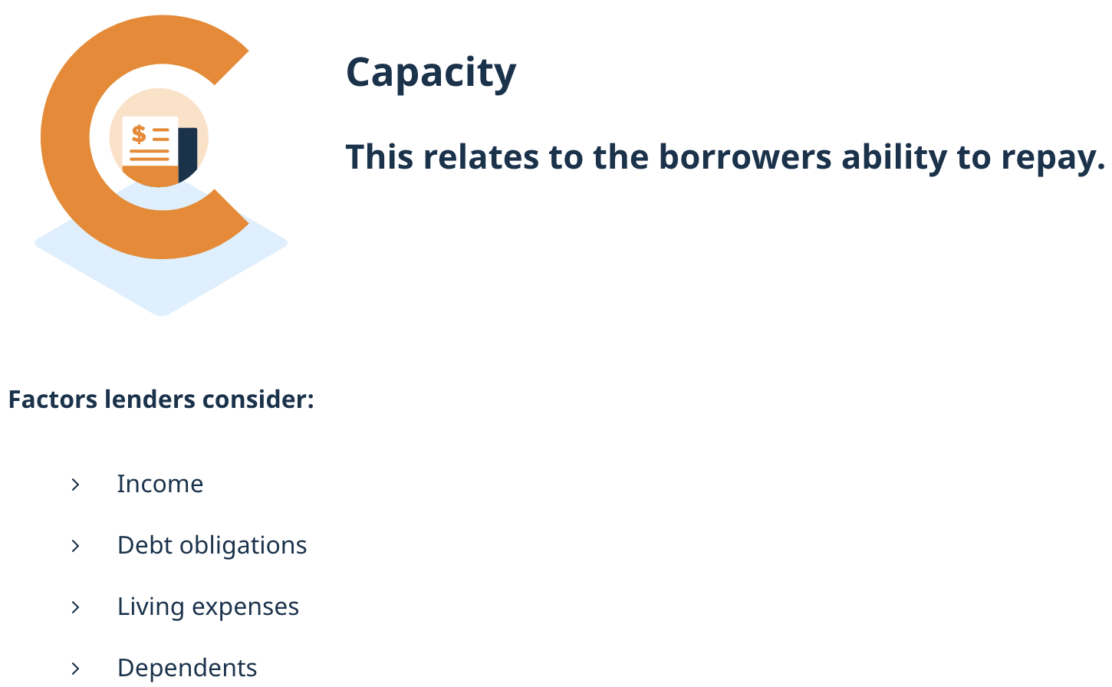
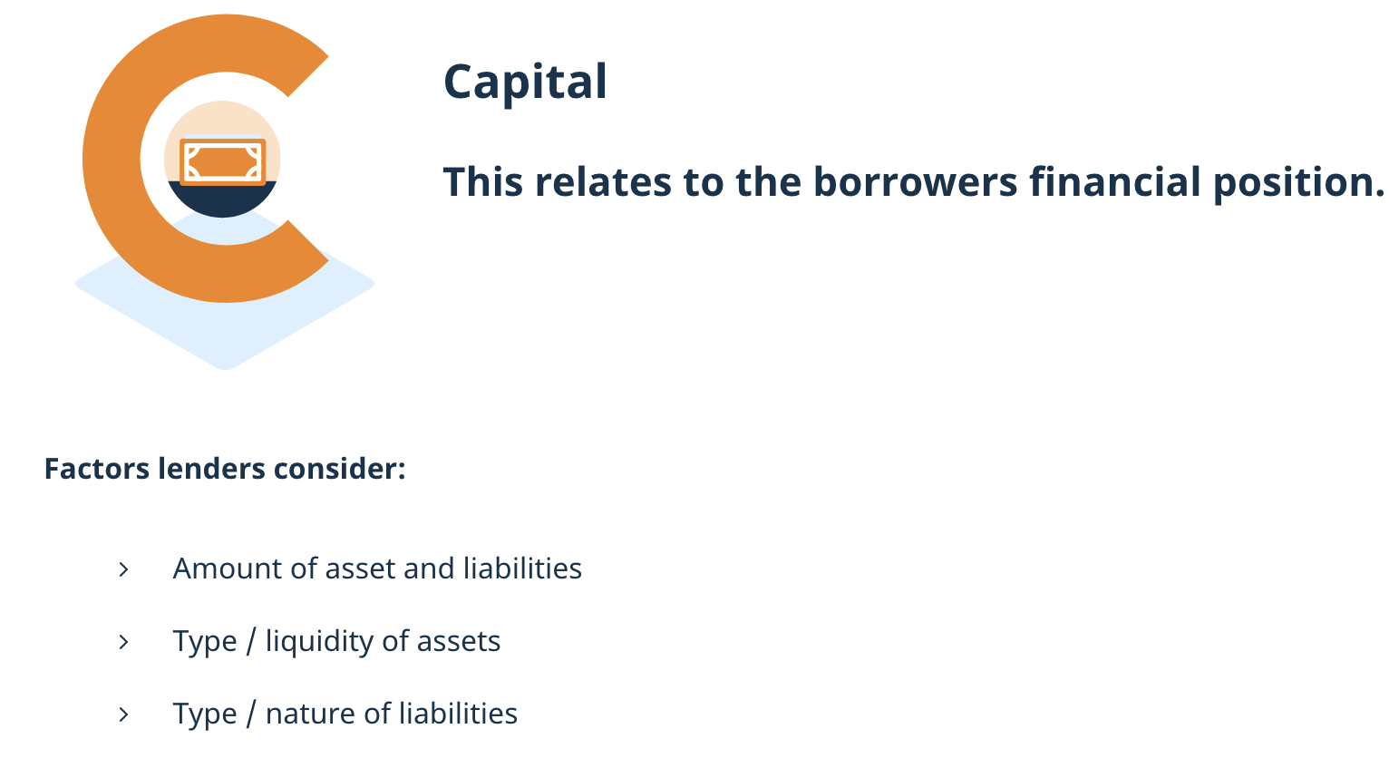
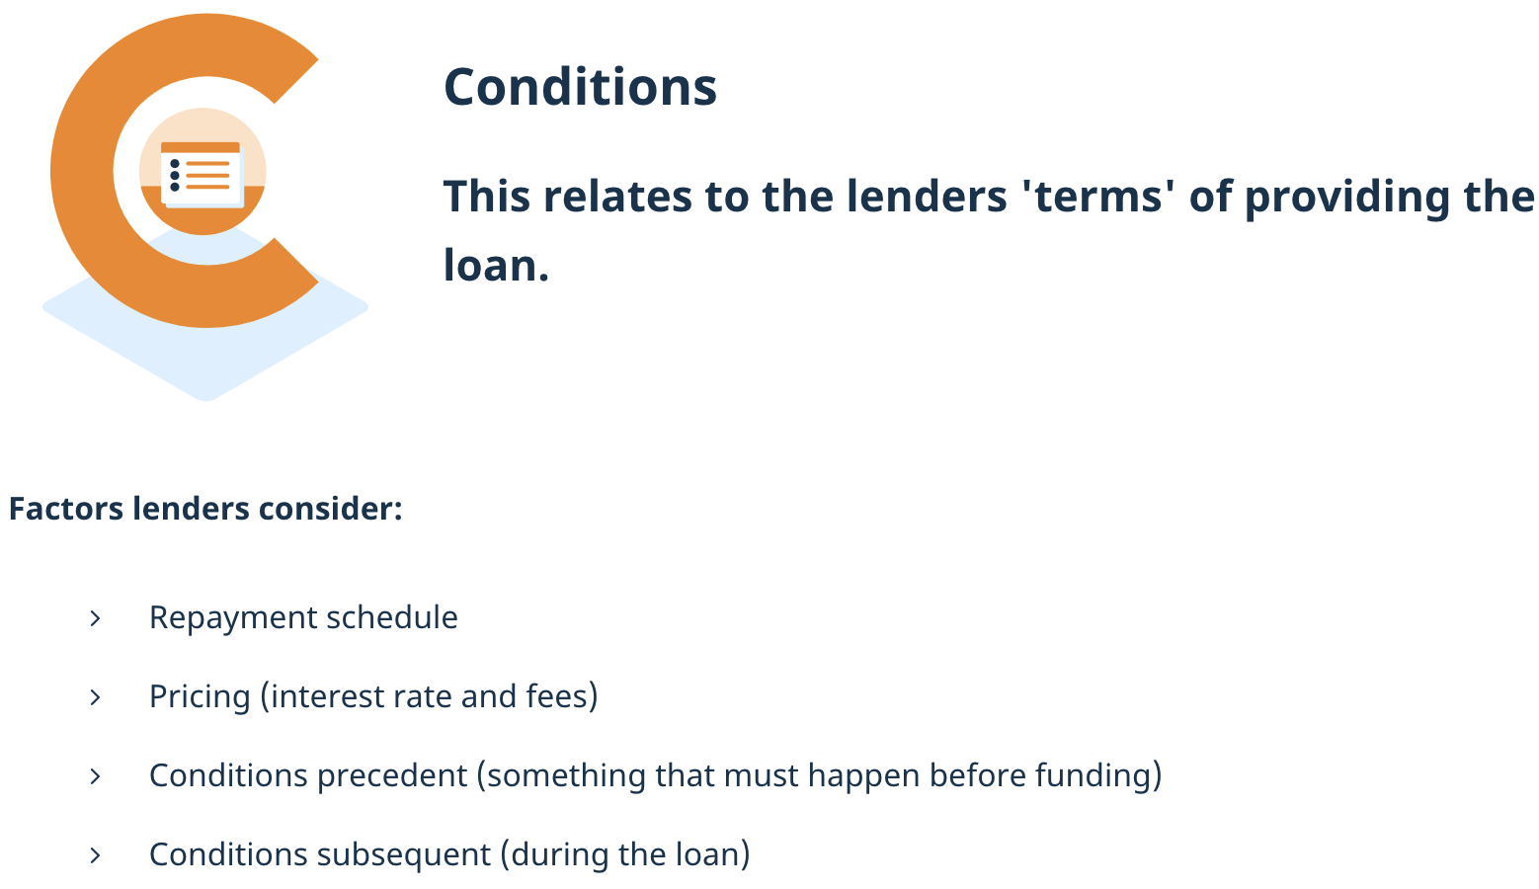
Australian Prudential Regulation Authority(APRA) eligibility criteria-The 5 C’s

Slide 4
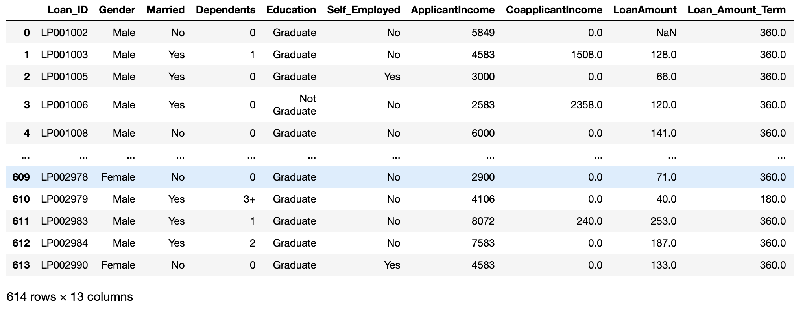
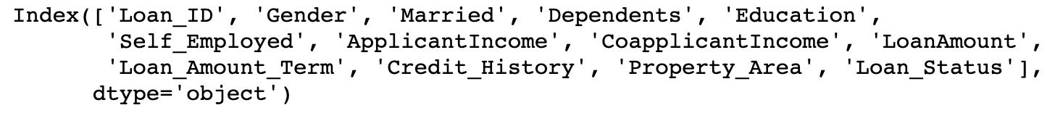
About the dataset
To find whether a customer is eligible based on the input parameters like Gender, Marital Status, Education, Number of Dependents, Income, Loan Amount, Credit History and others.

Slide 5
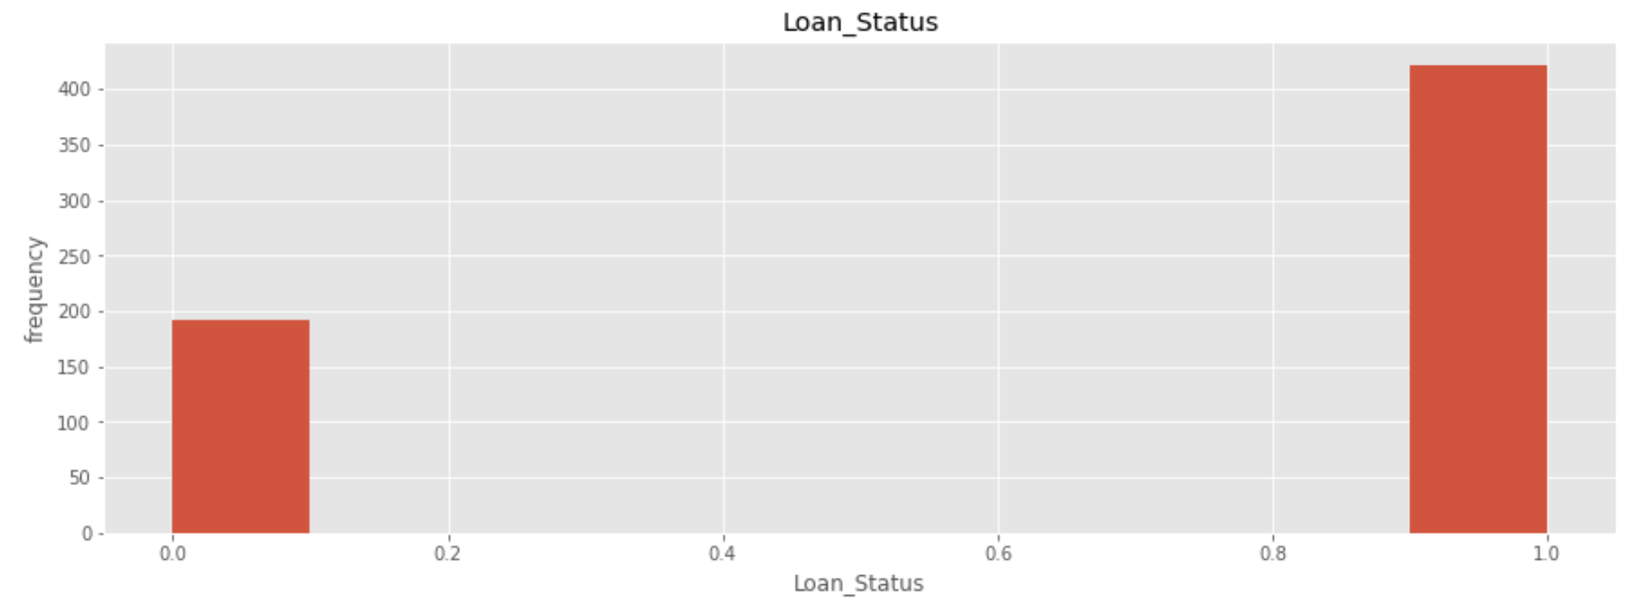
Target variable
‘Loan_Status’ selected
Binary classification
Outputs are imbalanced but some classifiers can handle this if correctly applied.

Slide 6


Analysis & visualization of input variables

Slide 7
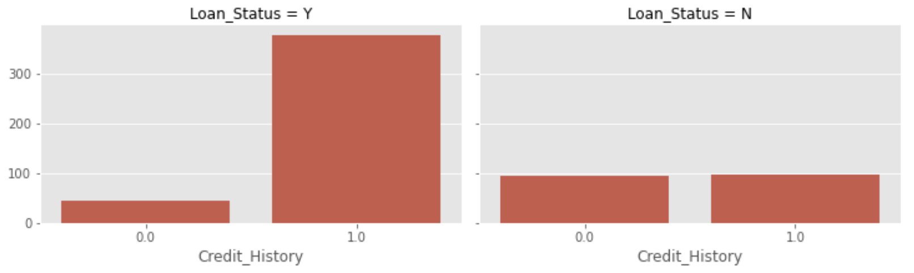
Credit History with Loan Status

Slide 8
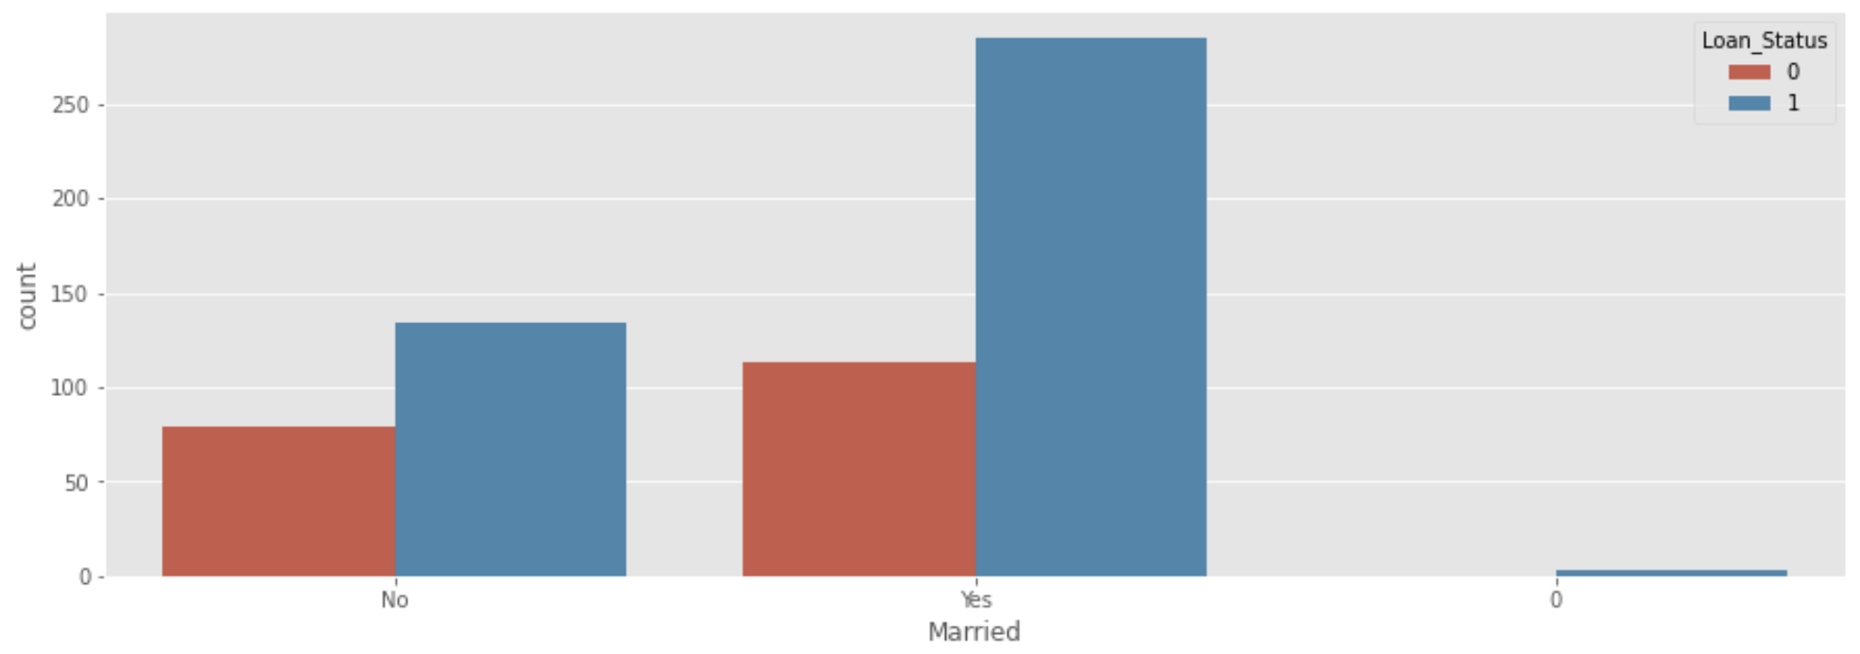
Marital status with Loan status

Slide 9
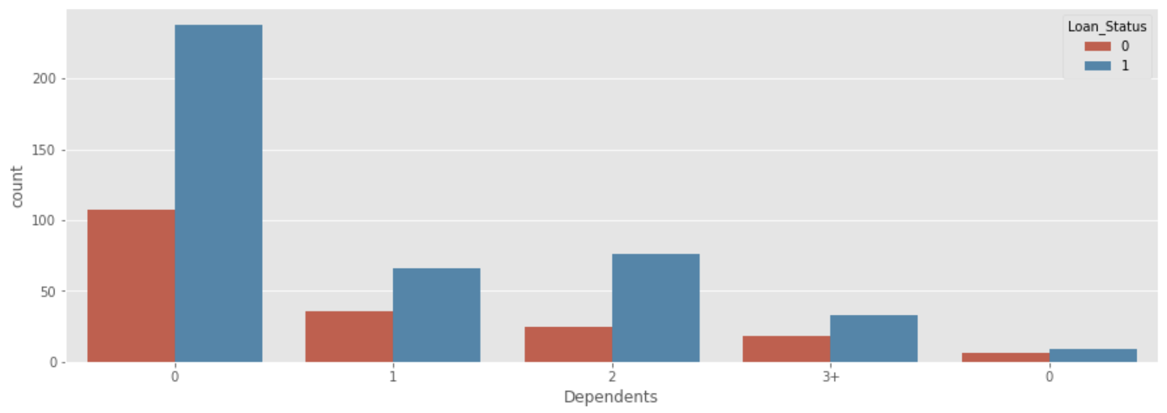
Dependents vs Loan Status

Slide 10
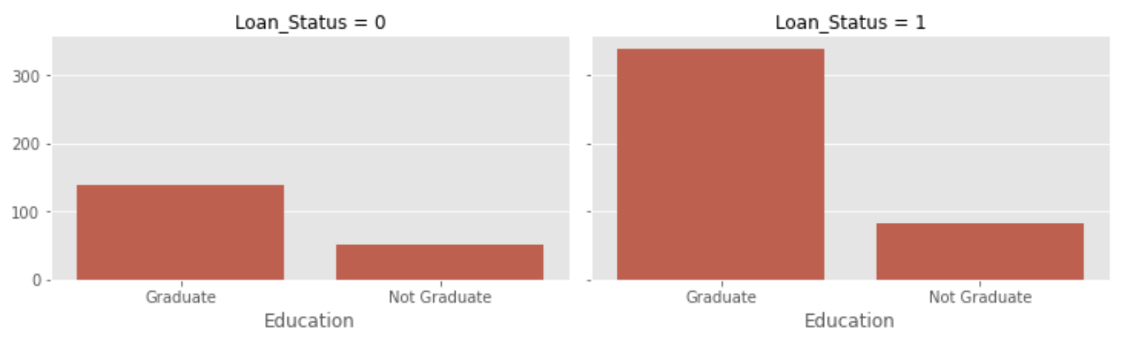
Education with Loan Status

Slide 11
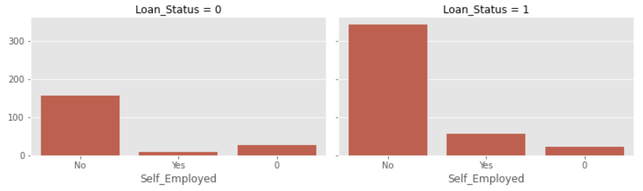
Self-employed with Loan Status

Slide 12
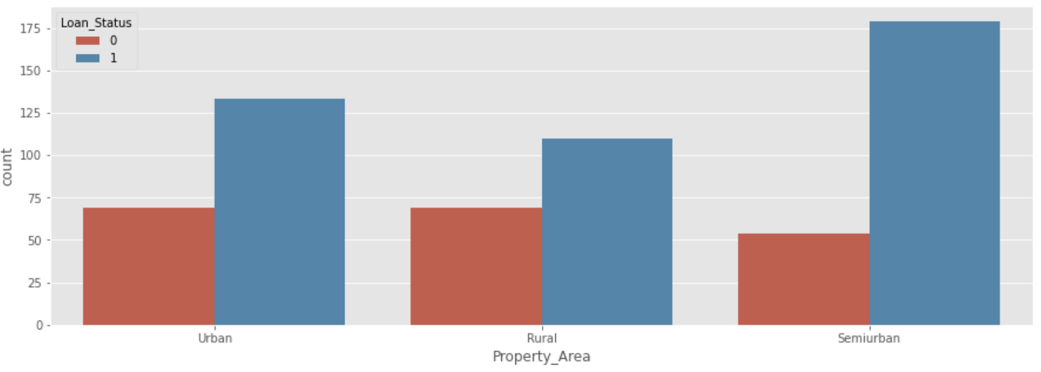
Property area vs Loan Status

Slide 13
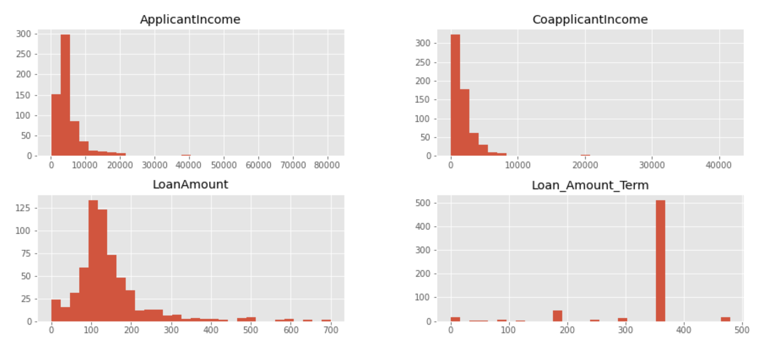
Analysis & visualization of input variables

Slide 14
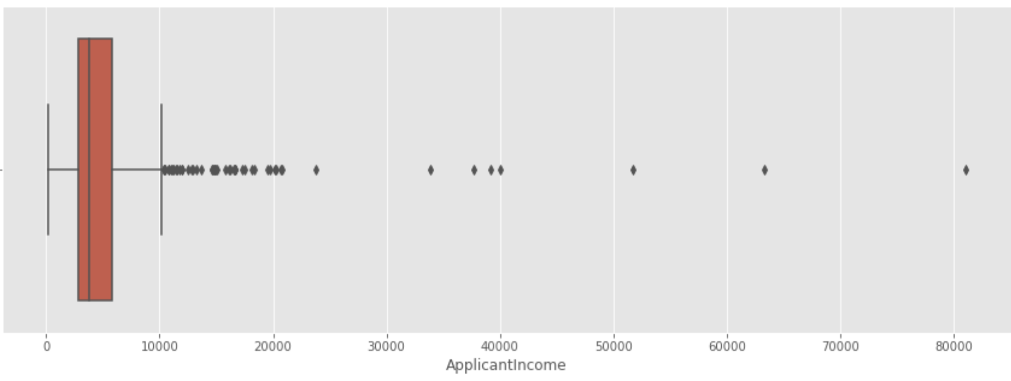
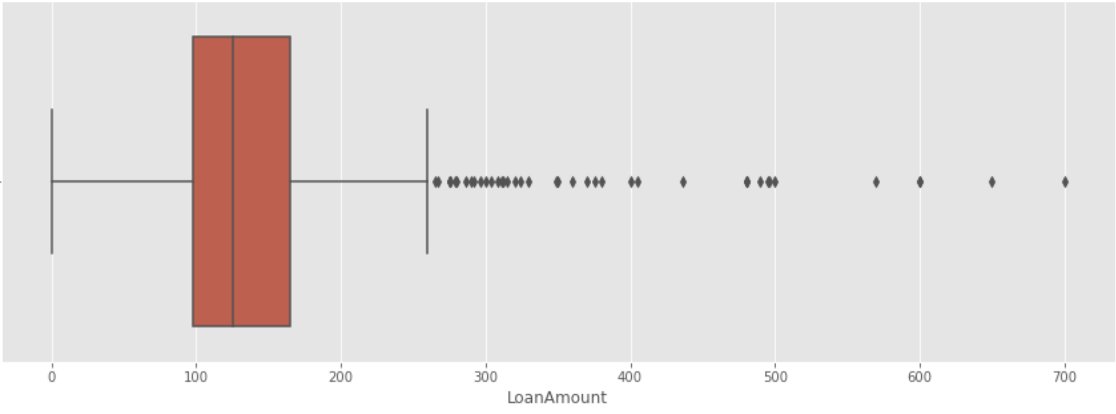
Detecting outliers
Outliers are expected in these type of features and it’s perfectly reasonable to not remove them.

Slide 15
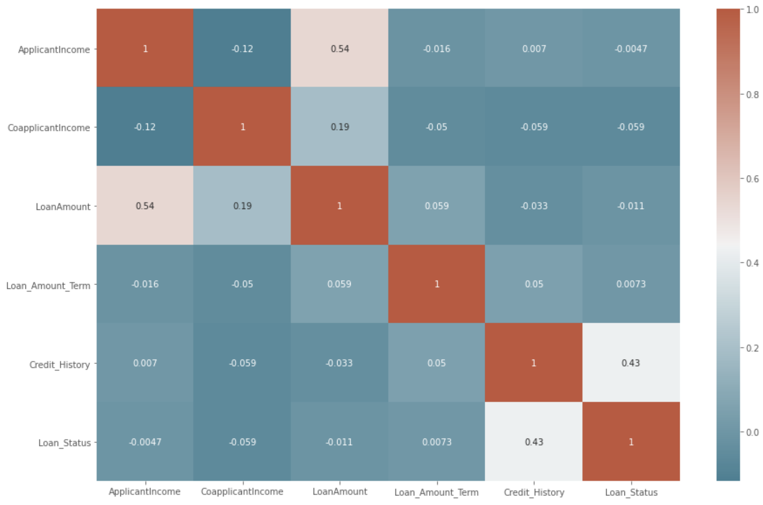
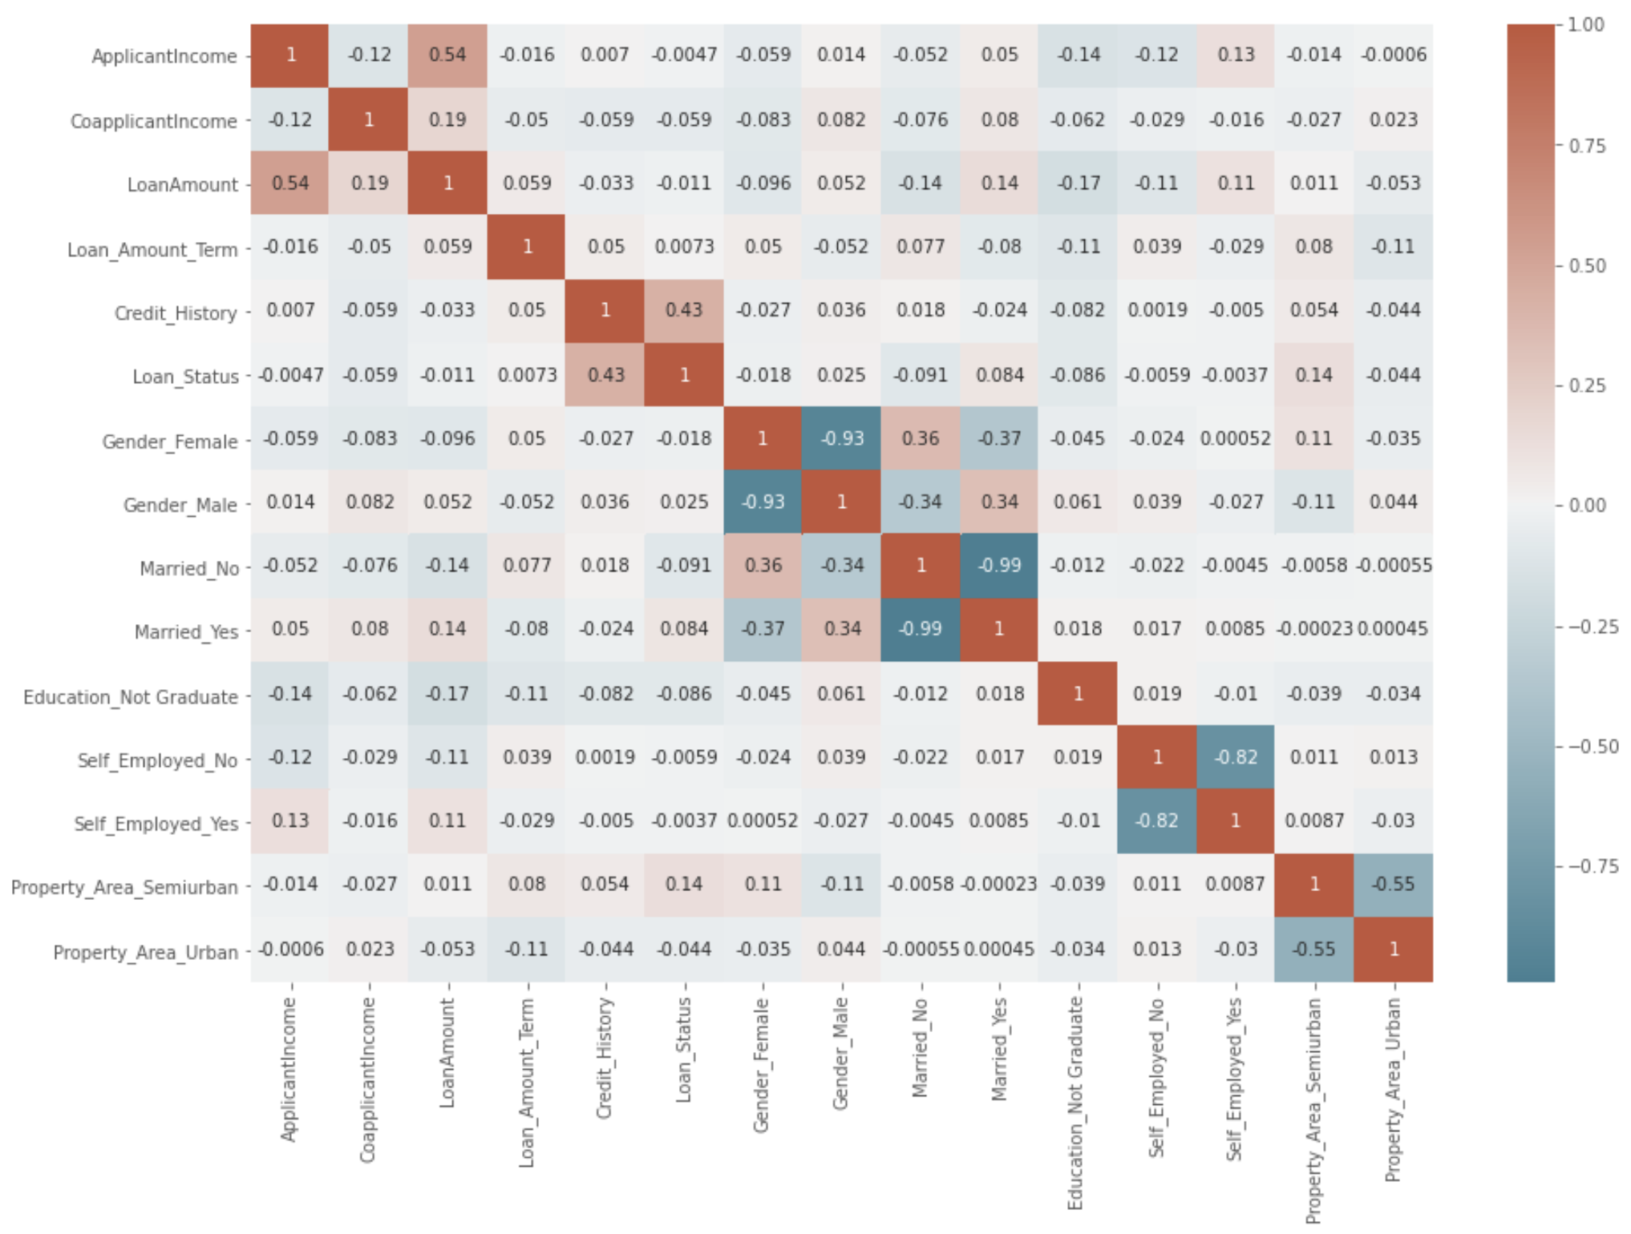
Feature selection & feature engineering

Slide 16
Implementation of models
Logistic Regression, SVM, Naïve Bayes, Decision Tree Classifier, Random Forest Classifier, KNN Classifier, ensemble methods
Handling imbalanced classes- Class weighting with Random Forest, Bagging with under sampling
Bagging-Under sampling- apply data resampling on the bootstrap sample prior to fitting the weak learner model. This is oversampling the minority class or under-sampling the majority class (called under bagging)
Use imbalanced-learn library modules.
Class weighting- from bootstrapping, the class distribution in the data sample will be different for each tree change. Considered class weighting based on the class distribution in each bootstrap sample, instead of the entire training dataset.
Bagging meta estimators- Taking base estimator as input along with parameters specifying the strategy to draw random subsets.

Slide 17
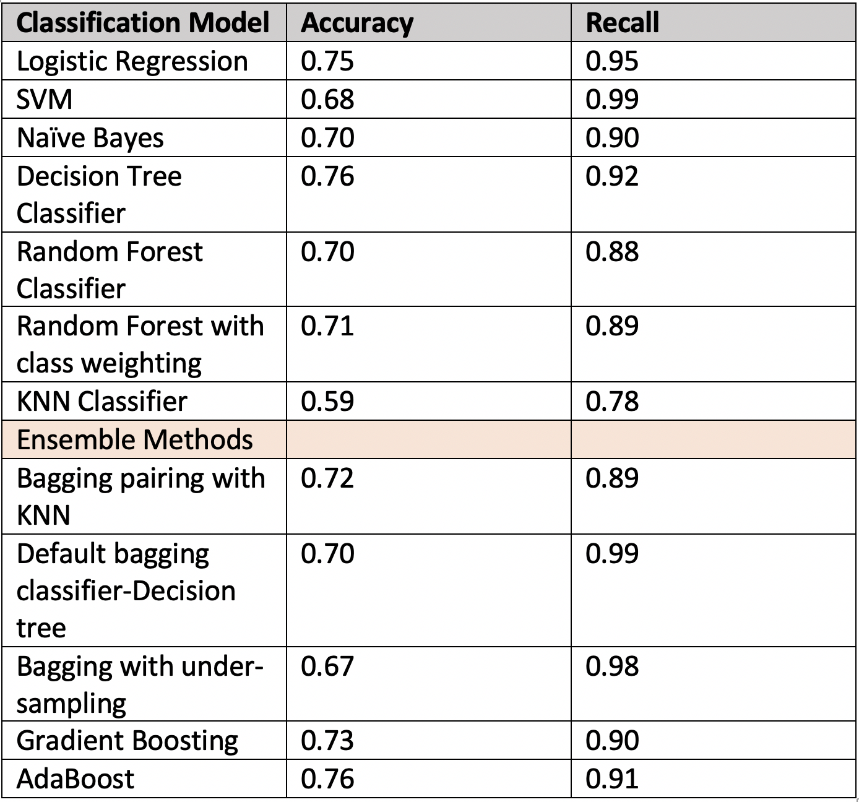
Classification models comparison

Slide 18
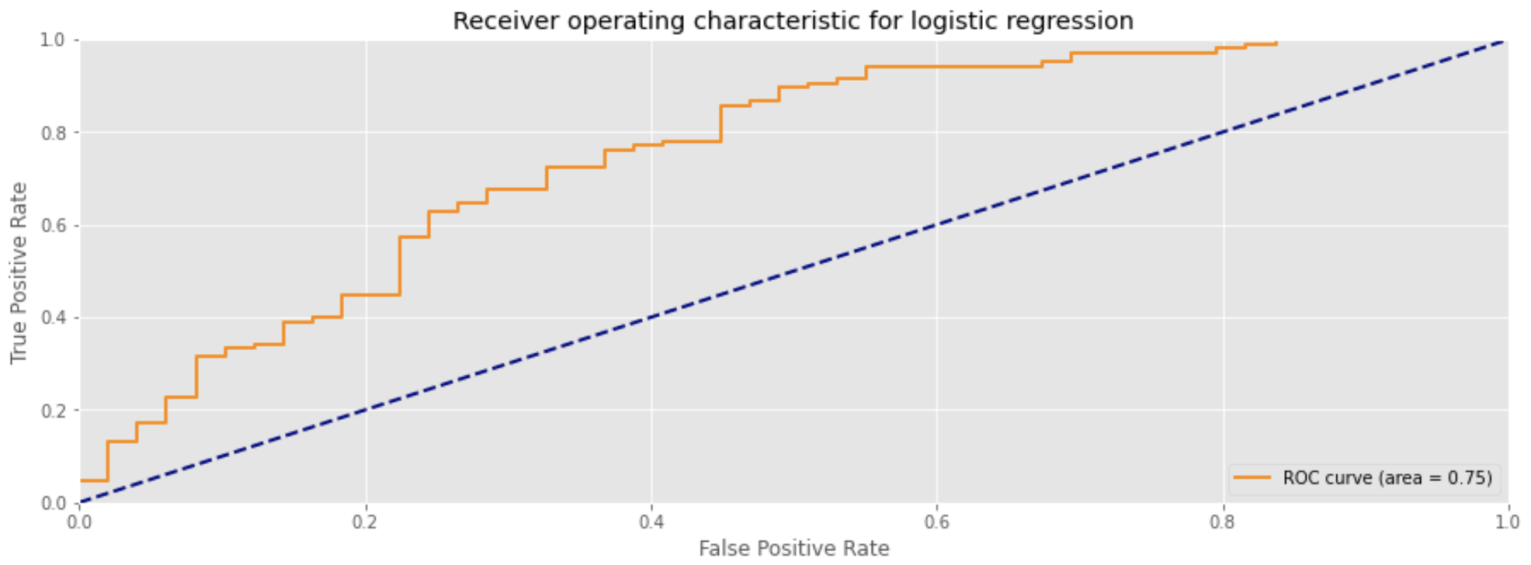
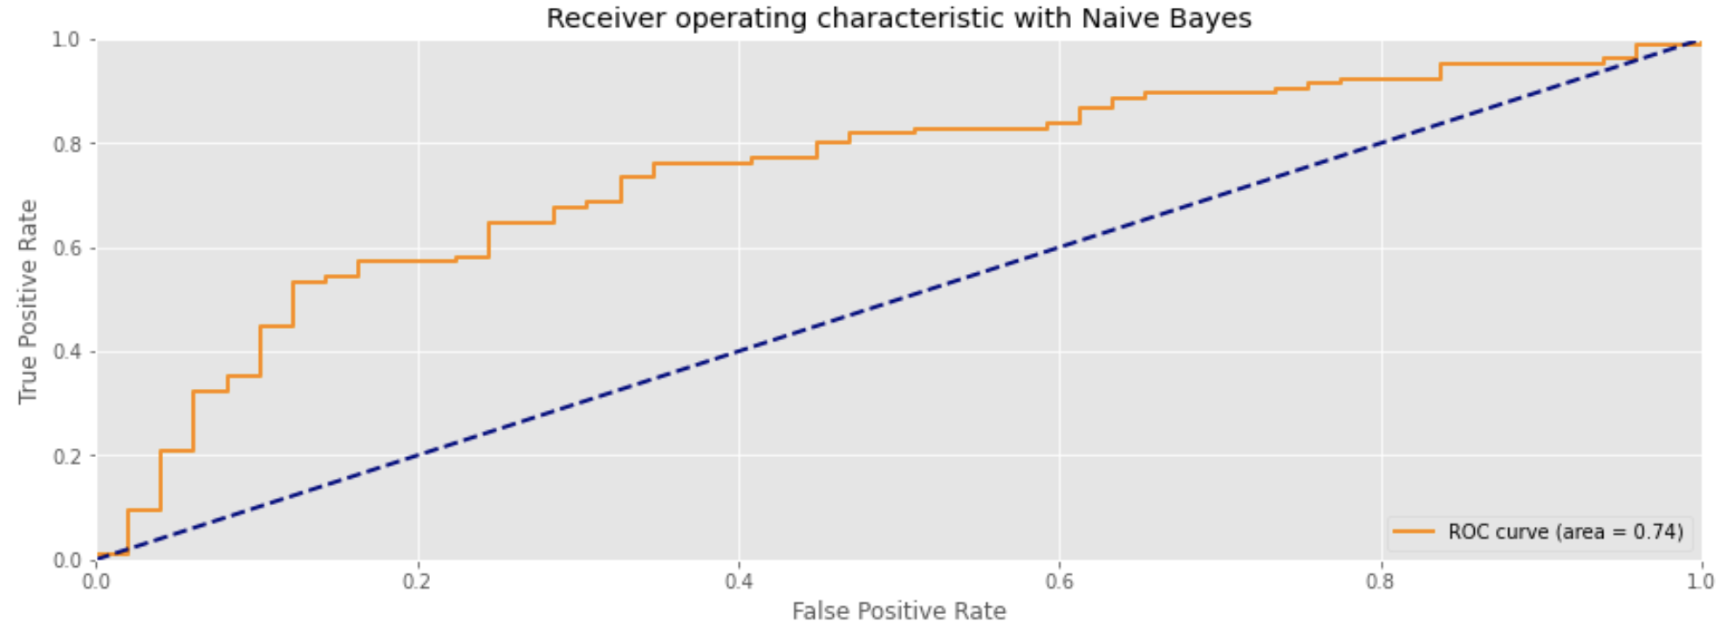
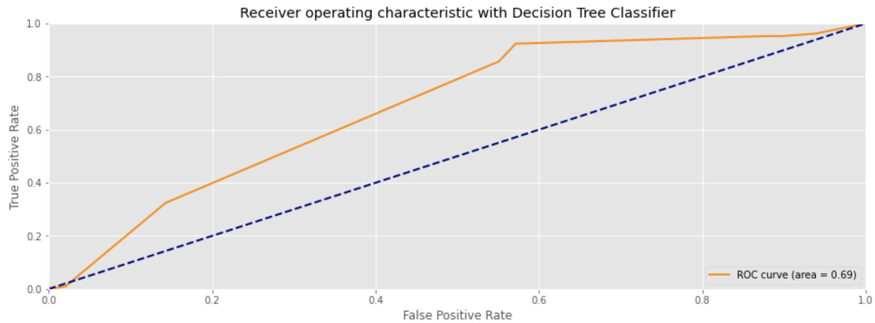
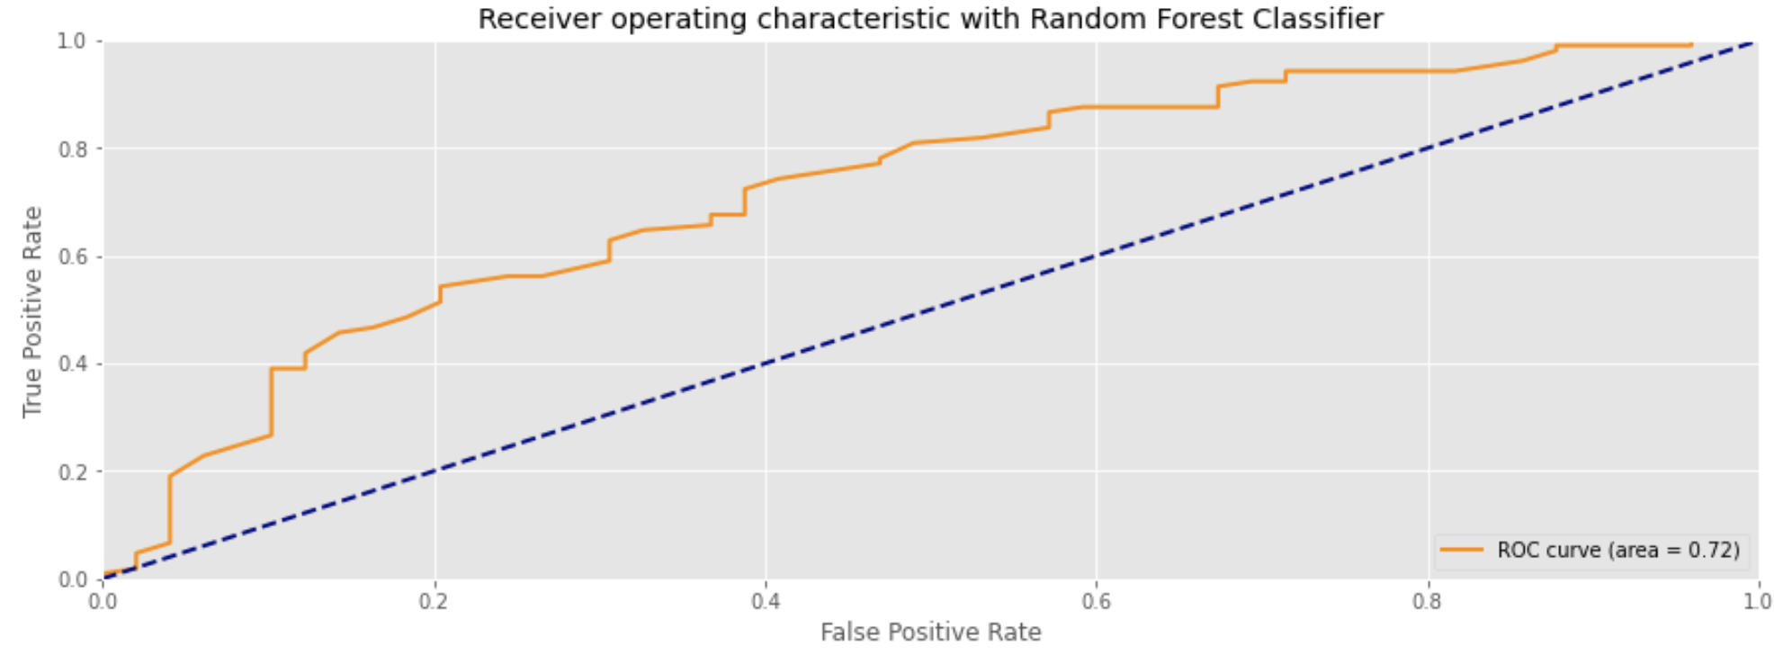
ROC Curves

Slide 19
Results & Conclusion
Logistic Regression, Decision Tree and Ada-boost performed well.
Class weighting and under sampling methods to cope with imbalanced classes helped improve the model performance.
Pairing ensemble method with base models helped improved the base model’s performance.

Slide 20
Future Tasks to improve the results
Perform hyperparameter tunning for the three selected models to further determine the best model (using Grid Search)
Inspect feature importance for the three models selected.
Apply ensemble other boosting methods on the dataset such as XGboost and Light GBM and use stacking ensemble method.

Slide 21
References
https://www.kaggle.com/yaheaal/loan-status-with-different-models
https://www.kaggle.com/sazid28/home-loan-prediction
https://www.youtube.com/watch?v=NqdyfMbVo1Q
https://machinelearningmastery.com/bagging-and-random-forest-for-imbalanced-classification/

Slide 22

Thank you!

